Slide 1
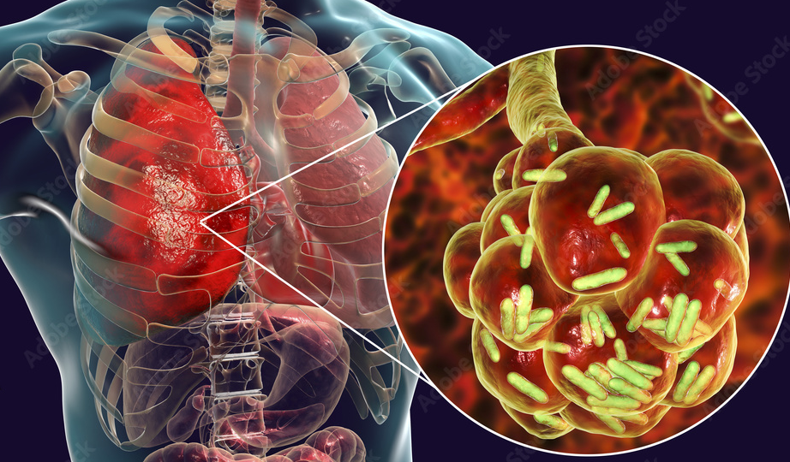
PREDICTION OF TYPES OF PNEUMONIA USING PNEUMOBOT
By:
Eshaan Mathakari
Kashyap Nadendla
Tanya Evita George
Zenith Mesa

Slide 2
WHAT IS PNEUMONIA?
Pneumonia is an infection that affects the lungs. It causes an inflammation in the alveoli (air sacs) of one or both the lungs where the alveoli tend to fill up with fluid or pus. Pneumonia can either be extremely dangerous, in some cases often leading to death, or it can also be mild all depending on individual factors such as age, general health and the cause of the infection such as bacteria, viruses or fungi.
Common symptoms include fever, chills and difficulty in breathing.
Diagnosis: A doctor or health care provider will usually review your medical history, conduct some tests and perform a physical exam. Often, a chest X-ray is taken to determine the presence of pneumonia.
Treatment normally includes antibiotics, viral or bacterial medication prescribed by a doctor. The recovery period could be across several weeks. If things get worse, one should almost immediately inform their doctor as things could become fatal.
Vaccines can be a preventive measure for pneumonia and work best when taken on time. Healthy lifestyle and proper hygiene also contribute a lot to prevention.

Slide 3

TYPES OF PNEUMONIA
Based on our dataset, these are the types we will be focusing on:
COVID-19: This kind of pneumonia is caused by the SARS-CoV-2 virus. Pneumonia caused as such is a very fatal complication as an aftereffect of the COVID-19 disease.
Normal: This type refers to cases where there is no infection present, and the lungs are completely healthy. Patients however may be suffering from symptoms like pneumonia but have a different underlying cause. For ex: asthma etc.
Bacterial Pneumonia: This type of pneumonia is most caused by a bacteria called Streptococcus pneumoniae. It can be treated by antibiotic treatment and symptoms often include high fevers, heavy cough with mucus and chest pains.
Viral Pneumonia: It is caused by viruses such as influenza, coronavirus or respiratory syncytial virus (RSV). The range of viral pneumonia lies between mild and severe. Unlike bacterial pneumonia, treatment needs to be implemented by dealing with the symptoms and helping the immune system recover. Antibiotics would not help in this case.

Slide 4
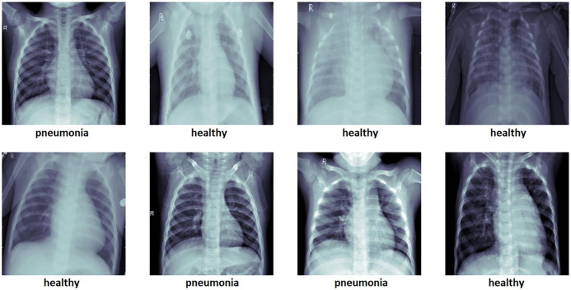
PUBLIC HEALTH QUESTION: "HOW TO IDENTIFY IF A PATIENT HAS PNEUMONIA AND DETERMINE ITS TYPE TO IMPROVE TIMELY TREATMENT?"

Slide 5
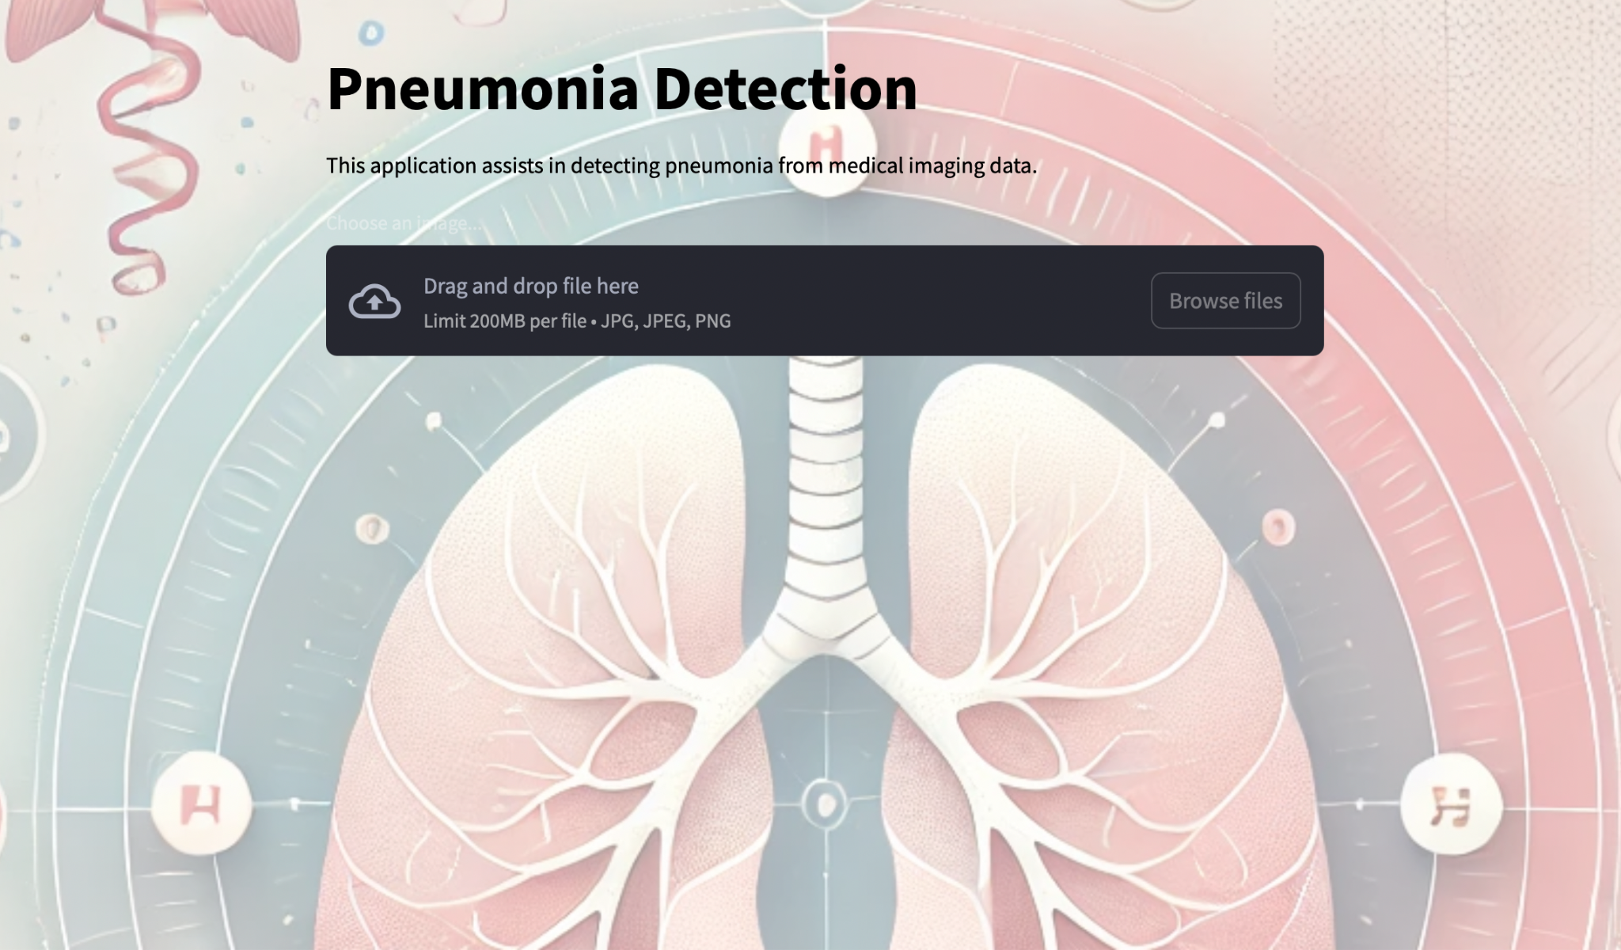
ANSWER:
Our project is based on a neural-network based pneumobot that takes an input image and diagnoses whether the patient has pneumonia or not and if they do, then the kind of pneumonia is specified as well.

Slide 6
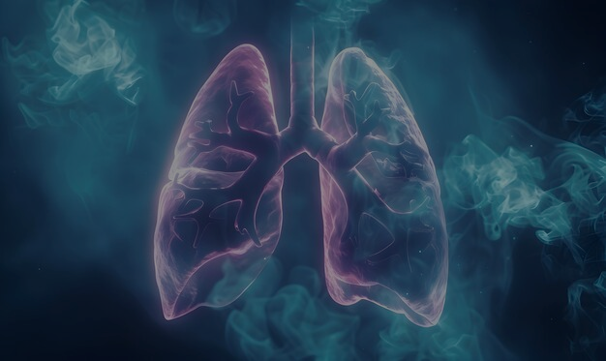
LITERATURE REVIEW - Techniques and Applications.
Pneumonia Detection Using CNNs and Transfer Learning
Inception-V3 and Transfer Learning
Rajaraman et al. (2023): Fine-tuning Inception-V3 achieved high accuracy in classifying pneumonia types. (MDPI)
Utilized pre trained ImageNet weights to reduce the need for large labeled datasets.
Demonstrated superior results and reduced training time compared to models trained from scratch.
Ensemble Models for Enhanced Performance
Liang et al. (2021): Combining DenseNet, ResNet, and GoogLeNet enhanced pneumonia classification. (PLOS ONE)
Ensemble methods addressed dataset biases and improved generalization.
Significantly reduced misclassification of bacterial, viral, and COVID-19 pneumonia.
Data Augmentation for Generalization
Alsharif and Qi (2023): Data augmentation techniques (rotation, flipping, zoom) improved model performance. (ArXiv)
Augmentation mitigated overfitting and enhanced the robustness of classification models.
Enabled CNNs to perform better on diverse and imbalanced datasets.

Slide 7
Literature Review - Advances and Challenges.
Advances in Multi-class Pneumonia Classification
Comparative Analysis of Pretrained Models
Alsharif and Qi (2023) highlighted DenseNet 201 and MobileNetV2 as effective models for distinguishing bacterial, viral, and COVID-19 pneumonia.
Grad-CAM explainability tools were used for visualization, aiding clinician validation. (ArXiv)
Real-world Applications
Pathak et al. (2023) discussed the practical deployment of AI-driven diagnostics for timely treatment.
AI-based decision support systems significantly reduced diagnostic time in clinical settings. (ArXiv)
Challenges and Limitations
Dataset biases due to imbalanced data across pneumonia types (Rajaraman et al., 2023).
Overfitting issues when using small, curated datasets (Singh et al., 2020).
Difficulty in distinguishing overlapping symptoms between bacterial and viral pneumonia (Alsharif and Qi, 2023).
Key Takeaways
Transfer learning and ensemble methods are effective for pneumonia classification.
Data quality, augmentation, and model explainability are critical for real-world adoption.
Addressing biases and improving datasets will enhance AI model robustness.

Slide 8
DATA SOURCE
We are using an image dataset that consists of chest X-ray images that are categorized into 4 different groups-
COVID-19: 1,281 images
Normal: 3,270 images
Pneumonia-Bacterial: 3,001 images
Pneumonia-Viral: 1,656 images
The sample size is 9,208 images.
Each image is labelled according to its diagnosis making it easy to choose training and test data.
This dataset is very useful for medical imaging research that can be used to make models to diagnose and classify pneumonia.
Visual comparisons, feature extraction and EDA can be easily performed on such organized data.

Slide 9
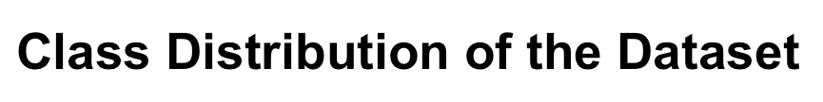
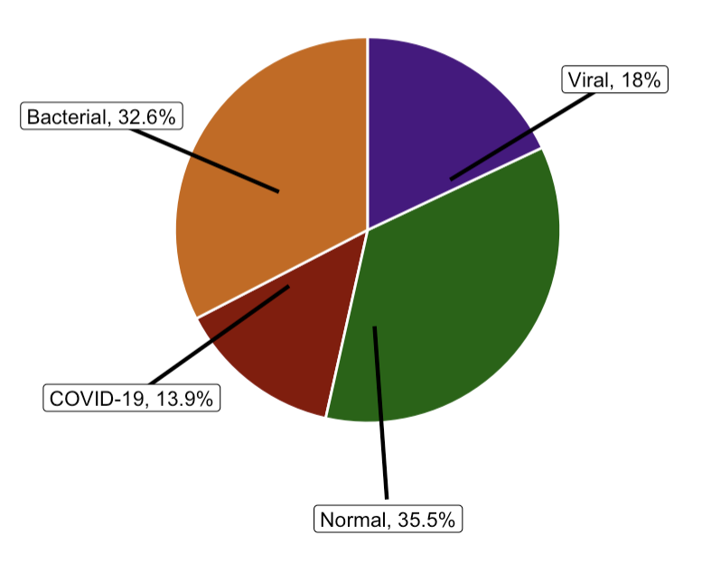
EXPLORATORY DATA ANALYSIS
The Pie-chart shows the class distribution of the four subdirectories of the dataset.
A clear observation here is that normal cases of Pneumonia are of the highest percentage giving us the inference that often Non-Pneumonia cases can easily be misdiagnosed if tests are not conducted properly.
While untreated bacterial pneumonia has a high mortality rate, COVID-19 pneumonia, despite being the lowest in percentage at 13% is also extremely fatal.

Slide 10
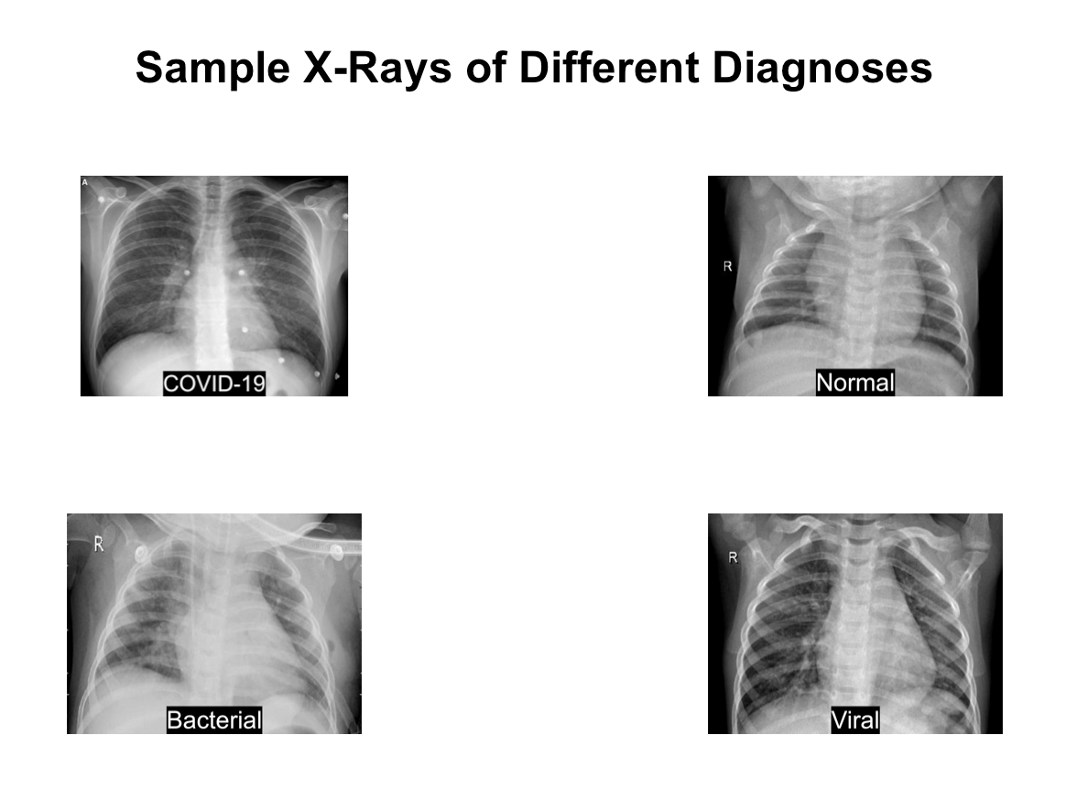
The grid of X-Ray images, gives a visual representation of the dataset.
People with non-medical backgrounds would find it difficult to understand whether the patient has Pneumonia and if yes, then what type?
Simple X-ray images won’t help with diagnosis, our Pneumobot makes this much easier.

Slide 11
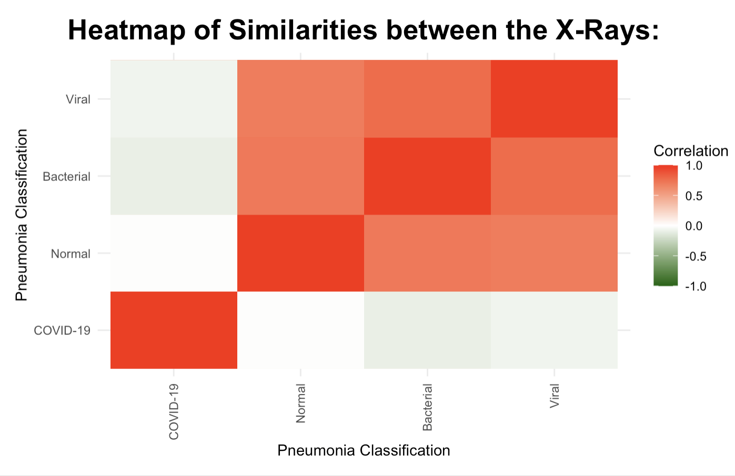
The heatmap provides a clear visualization of the X-Ray images that shows how similar they are to each other.
This further confirms the need for a system that can swiftly and efficiently classify the type of pneumonia so that suitable treatment can be administered to patients.

Slide 12
MODEL ARCHITECTURE
Base Model: Utilizes DenseNet121 with pre-trained weights for feature extraction.
Custom Layers: Includes Global Average Pooling, Dropout, and a Dense output layer with softmax activation for classification.
Training: Optimized and trained using labeled chest X-ray images for pneumonia detection.
Retraining Mechanism
Feedback Collection: User feedback is stored in the feedback_data/ directory.
Automatic Retraining: Retraining is triggered automatically when the number of feedback entries reaches a predefined threshold (e.g., 10).
Model Update: Incorporates new data to retrain the model and saves the updated version.
Dynamic Model Loading: The app seamlessly loads the updated model post-retraining for real-time improvements.

Slide 13
CHATBOT INTEGRATION:
PneumoBot Features:
FAQ Bot: Provides quick answers to frequently asked questions.
GPT-4o Bot: Leverages OpenAI's GPT-3 for detailed and intelligent responses.
Accessibility: Available under the "Chatbot" tab in the application for user interaction and support.
Key Features
Real-time Feedback Utilization: Enhances model accuracy with continuous retraining.
User-Friendly Interaction: Combines machine learning and AI-powered assistance for a holistic user experience.

Slide 14
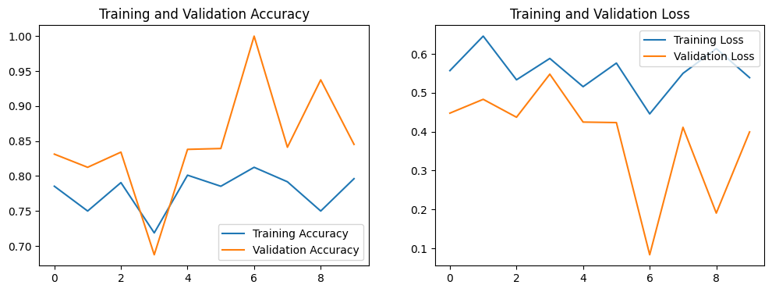
ACCURACY GRAPH:
Upon comparing, the training accuracy has a more steady growth while the validation accuracy is observed to fluctuate a lot.
The validation loss drops the most at the 6th epoch and then rises again showing inconsistency and that the model might not react well to unseen data.

Slide 15
RESULTS
Accuracy | Measurement | Achieved
Training | % | 81.25
Validation | % | 93.16
Test | % | 84

Slide 16
CONCLUSION
Our project supports and demonstrates deep learning and feedback-based retraining for the detection of types of pneumonia from X-ray images.
The pneumobot attained a training accuracy of 81.25%.
It classifies an input image as either having COVID-19, Normal, Bacterial or Viral type of pneumonia.
The bot is coded in with a feedback loop that takes feedback from the user to give better accuracy and fine-tuning is done to increase adaptability to real-life situations.
The feedback method makes sure the model is robust and capable of handling different types of inputs.

Slide 17

DESIGN CONSTRAINTS
We were unable to retrain the model based on every feedback as it was overfitting the model.
Retraining after every other feedback is also a computationally expensive process.

Slide 18
POTENTIAL MODEL IMPROVEMENTS WITH PNEUMOBOT
Adding classification and diagnosis of more than just Pneumonia such as Tuberculosis, lung cancer, Parkinson’s disease, Alzheimer’s, different types of cancers and even COVID-19.
Simple or basic healthcare suggestions, indications of symptoms can also be given to the user after feeding image input instead of just classifying the type of disease.
The functionality of the Pneumobot can be modified to manage real-time data for at-risk patients

Slide 19
REFERENCES
R. Kundu, R. Das, Z. W. Geem, G.-T. Han, and R. Sarkar, "Pneumonia detection in chest X-ray images using an ensemble of deep learning models," PLOS ONE, vol. 16, no. 9, pp. 1–21, Sep. 2021. [Online]. Available: https://journals.plos.org/plosone/article?id=10.1371/journal.pone.0256630
V. P. Vianna, "Study and development of a Computer-Aided Diagnosis system for classification of chest X-ray images using convolutional neural networks pre-trained for ImageNet and data augmentation," arXiv preprint arXiv:1806.00839, Jun. 2018. [Online]. Available: https://arxiv.org/abs/1806.00839
D. Avola, A. Bacciu, L. Cinque, A. Fagioli, M. R. Marini, and R. Taiello, "Study on transfer learning capabilities for pneumonia classification in chest X-rays image," Computer Methods and Programs in Biomedicine, vol. 226, p. 106833, Apr. 2022. [Online]. Available: https://arxiv.org/abs/2110.02780
A. Mabrouk, R. P. Díaz Redondo, A. Dahou, M. A. Elaziz, and M. Kayed, "Pneumonia detection on chest X-ray images using ensemble of deep convolutional neural networks," Applied Sciences, vol. 12, no. 13, p. 6448, Jul. 2022. [Online]. Available: https://arxiv.org/abs/2312.07965
T. Rahman et al., "Transfer learning with deep convolutional neural network (CNN) for pneumonia detection using chest X-ray," Applied Sciences, vol. 10, no. 9, p. 3233, Apr. 2020. [Online]. Available: https://arxiv.org/abs/2004.06578
A. M. Khan et al., "Pneumonia classification from X-ray images with Inception-V3 and convolutional neural network," Diagnostics, vol. 12, no. 5, p. 1280, May 2022. [Online]. Available: https://www.mdpi.com/2075-4418/12/5/1280

Slide 20

THANK YOU

